Slide 1


BONUS VOUCHER

Slide 2
idea:
The idea is to stop issuing bonus cheques to the product center and replace with something new that is beneficial for the Company, Staffs and FBOs.

Slide 3
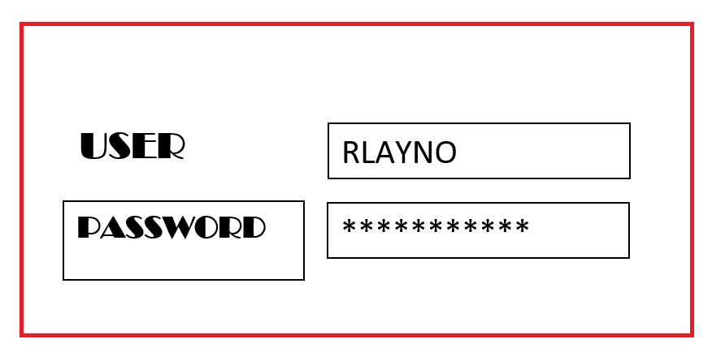
SAMPLE

Slide 4
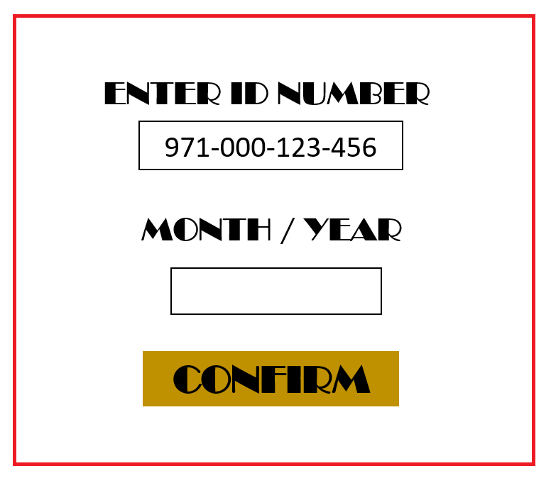
SAMPLE

Slide 5
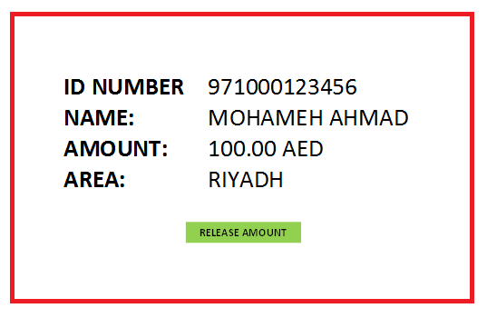
SAMPLE

Slide 6
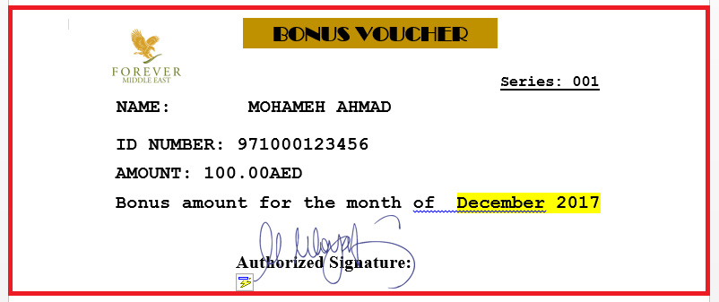
SAMPLE

